Slide 1
Demand Forecasting For Food Supply Chain Using LSTM Neural Networks
Kaushik S, Abhishek Raman

Slide 2
Introduction to the problem
Excess supply or stocking can prove to be counterproductive in case of demand fluctuations in the market as the perishable inventory needs to be disposed in case of an unanticipated drop in demand.
Also, when the supply is scanty, an upsurge in demand can quickly overwhelm the inventory, resulting in a stock out. Both scenarios have adverse financial repercussions.
A plausible solution would be to represent demand as a probability distribution with a temporal component and the nature of this probability distribution can be estimated by a time series forecasting algorithm

Slide 3
OUR SOLUTION
The described problem is addressed by training an LSTM neural network on the historical time series data of market demand to analyze patterns and trends that the data follows.
After successful training, the LSTM network will be able to provide accurate estimates of market demand in the future.
Consequently, the inventory levels can be modelled as a function of the LSTM time series forecast.

Slide 4
LONG SHORT TERM MEMORY
Long short-term memory (LSTM) is an artificial recurrent neural network (RNN) architecture used in the field of deep learning.
Unlike standard feedforward neural networks, LSTM has feedback connections.
It can not only process single data points (such as images), but also entire sequences of data (such as speech or video). A common LSTM unit is composed of a cell, an input gate, an output gate and a forget gate.
The cell remembers values over arbitrary time intervals and the three gates regulate the flow of information into and out of the cell.
LSTM networks are well-suited to classifying, processing and making predictions based on time series data, since there can be lags of unknown duration between important events in a time series.

Slide 5
FRONT END USING FLASK
Flask is a micro web framework written in Python.
The LSTM model was deployed using this framework to perform real time and online training on new and unseen datasets for demand forecasting.
When the user feeds in a dataset consisting of weekly demand of food, the LSTM model will train on this dataset and predict future demand of food.
The Flask framework downloads these predictions in the form of csv.

Slide 6
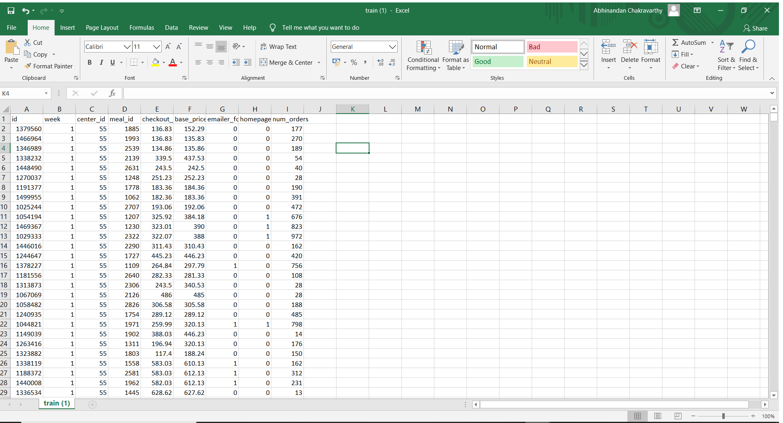
The Training Dataset

Slide 7
DATASET
The data was assimilated from kaggle. The data consisted of excel files comprising of fulfilment center information, meal id and types and historical data going back about 2.8 years.
The data was cleaned by removing/replacing alpha, alpha-numeric values to only integer/float values.
Redundant columns that do not contribute to the prediction result were identified and eliminated.

Slide 8
DATA PREPROCESSING
LSTM requires 3 dimensional data input for training and prediction, the columns are 1 dimensional array, hence they are reshaped into 3 dimensional format using numpy library. Mainly the number of orders is reshaped to confer with LSTM input format.
The contributing columns like week, center ID and number of orders comprise the final dataset which is split into training, testing and validation by applying appropriate split ratio.

Slide 9
RESULTS AND CONCLUSION
An LSTM neural network was successfully trained for food demand forecasting from week 145 to week 155.
The results were generated in the form of a csv file. The LSTM model was deployed for real time training using Flask library in Python.
The user can upload a custom dataset conforming to the specified format, train the LSTM model and generate results for the custom dataset. The training is real time unlike other static models.

Slide 10
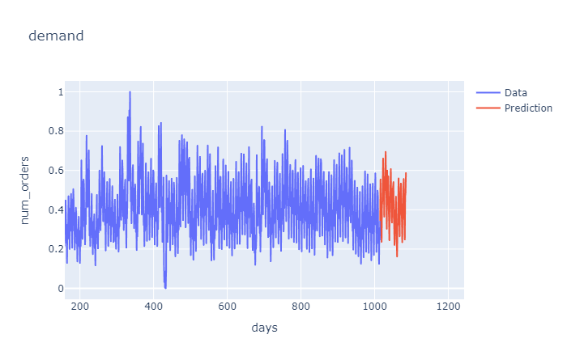
RESULTS

